Slide 1
29.04.2016
Sala Della Torre, Fondazione Cassa di Risparmio di Gorizia, Via Carducci 2, Gorizia
"Il contrasto al cyberbullismo come forma di discorso d'odio attraverso il
No Hate Speech Movement: esempi concreti di azioni online e offline"
DOTT.SSA ALESSANDRA COPPOLA
Presidente APICE e Coordinatrice della Rete APICE per il NHSM

Slide 2

IL CONTRASTO AL CYBERBULLISMO COME FORMA DI HATE SPEECH: LE EUROPEAN ACTION DAYS FOR SAFER INTERNET

Slide 3
LE AZIONI PROPOSTE A LIVELLO EUROPEO
ACTION 1. Learning online and hate speech Internet provides a space for learning and communicating for young people. In order to protect yourself from online hate speech you must have certain skills and understanding. Read and share these INFOCARDS about online hate speech and you will know better what to do when you face online hate speech. | ACTION 2. Cyberbullying and hate speech Internet is a space for interaction among young people. Just like in offline world young people can themself be actors of hatered or targets of hatered. Hate speech is often used in cyberbullying. In order to understand what to do: Read and share these GUIDELINES to prevent and counter act cyberbullying and hate speech, and see and share these MEMES to raise awarness about the problem. Play one of the Selected Educational Activities with your group of youth and give us your feedback in a comment.
ACTION 3. Identity safety and hate speech Internet is place to share information about your own identity which can also expose you at risks of hate speech, bullying and physical or emotional dangers. So protecting your own identity online is your responsability as well. Play this exercise online "WHAT WOULD YOu SHARE?". Read and share this ARTICLE about your Right to Privacy and watch this VIDEO WITH 3 QUESTION about risks and consequences of sharing too much about yourself online, and share your answers to the three questions on our Facebook page | ACTION 4. Personal history and hate speech Internet remembers everything that you have shared, done online in your past. This can also make you vulnarable in relation to hatered and hate speech online. Read and share these INFOCARDS that can make you and your friends think about the problem and act better to protect your and other's history online.
ACTION 5. Terms and conditions and hate speech Internet is full of content providing and social media services that all have rules in their Terms and Conditions. Usually people do not read them, however they contain a lot of information about safety issues, prevention and hate speech. Read and share this article CARE WHAT YOU AGREE ONLINE!. Read and share this INFOCARD too. | ACTION 6. Report online hate speech that is online hate content in relation to safety, cyberbullying and any hatefull content that promotes discrimination and hatred among young people online. Read the focus of the month on Hate Speech Watch and report cases. Activists will select the most outstanding reports for further actions.

Slide 4
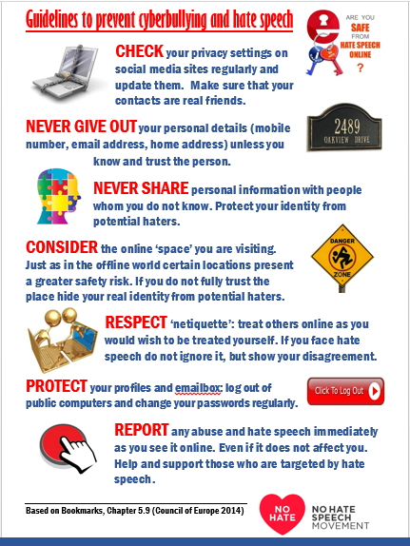
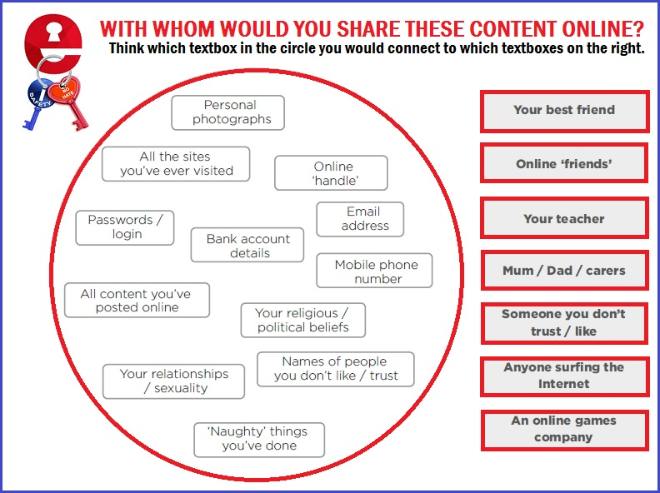

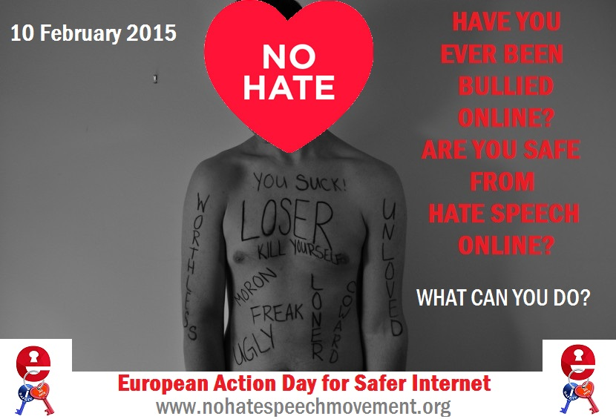
MATERIALI E CONTENUTI

Slide 5

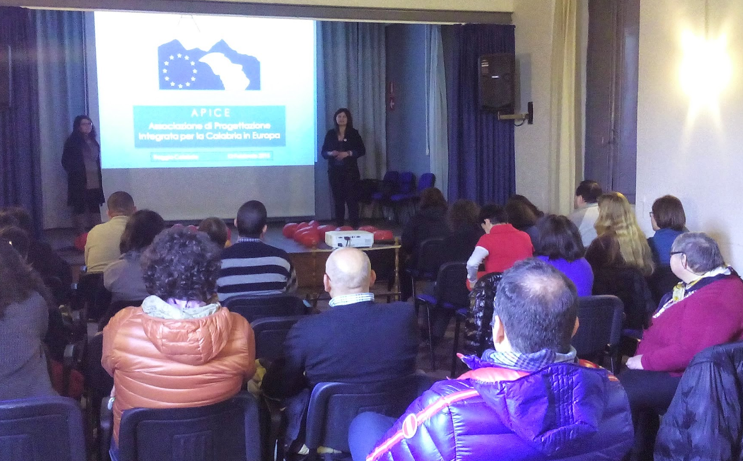
BUONE PRATICHE CONTRO IL CYBERBULLISMO IN ITALIA NEL CONTESTO DEL “NO HATE SPEECH MOVEMENT”. Azioni offline nel contesto locale, per la tutela dei disabili contro il discorso d'odio

Slide 6
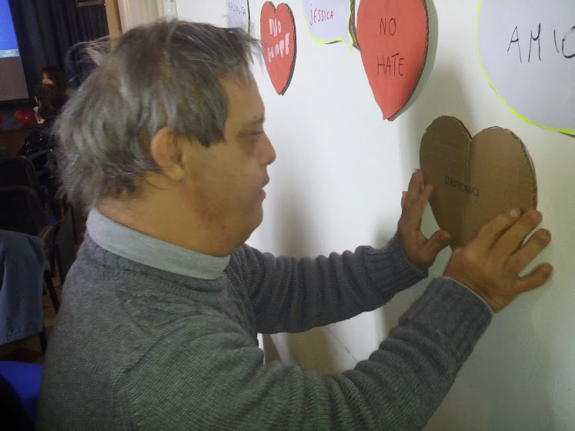
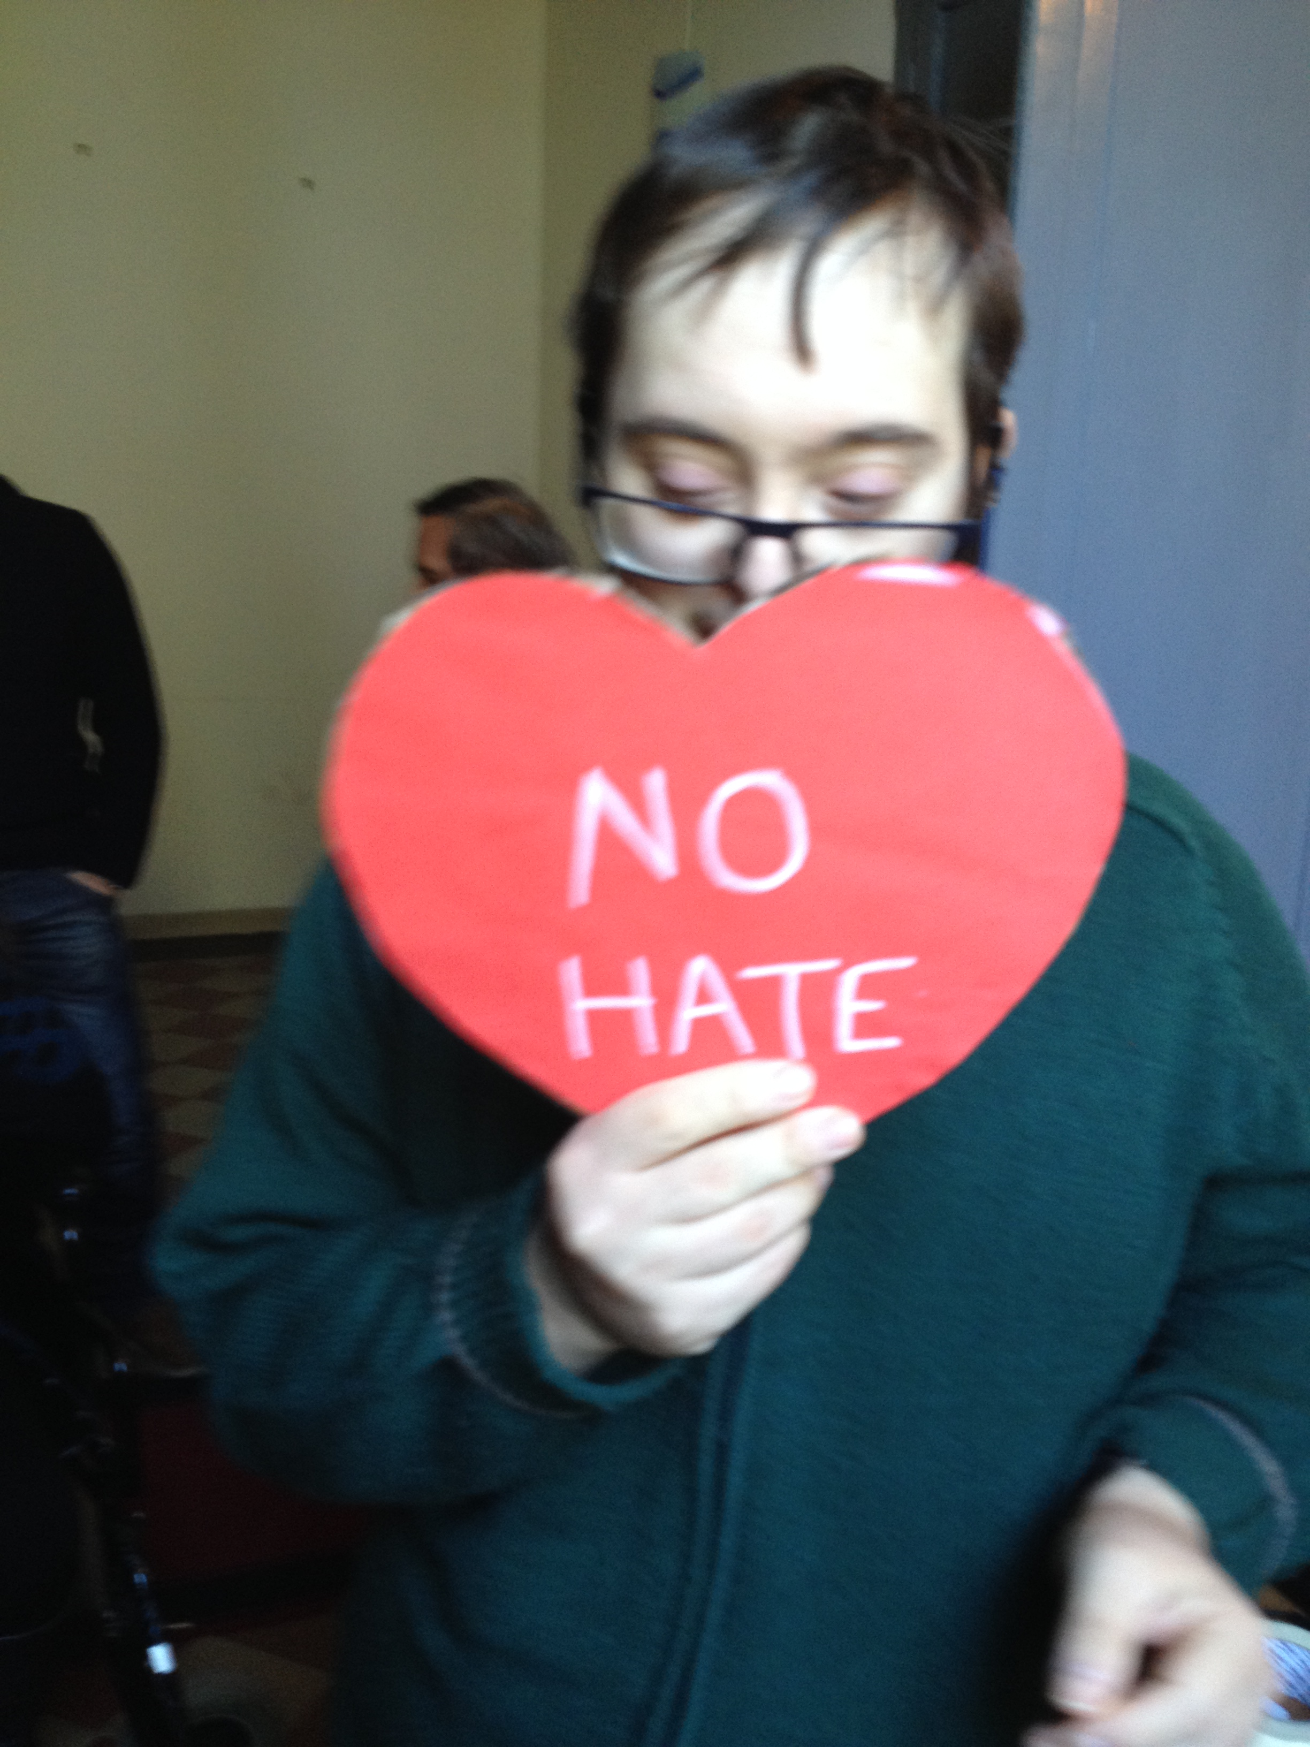
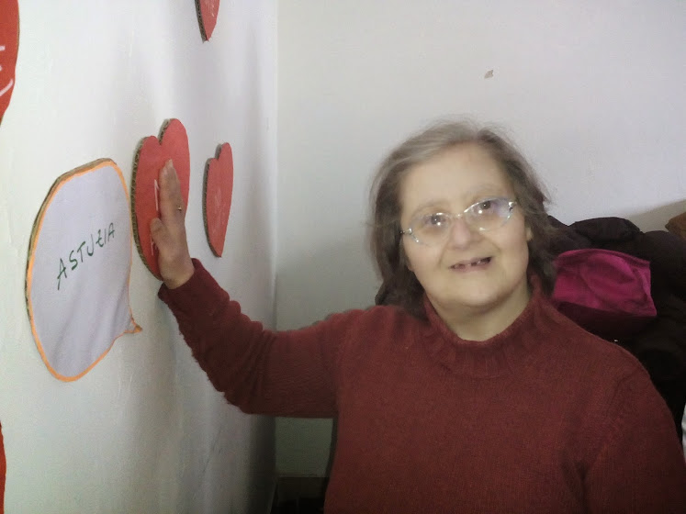
I PROTAGONISTI

Slide 7
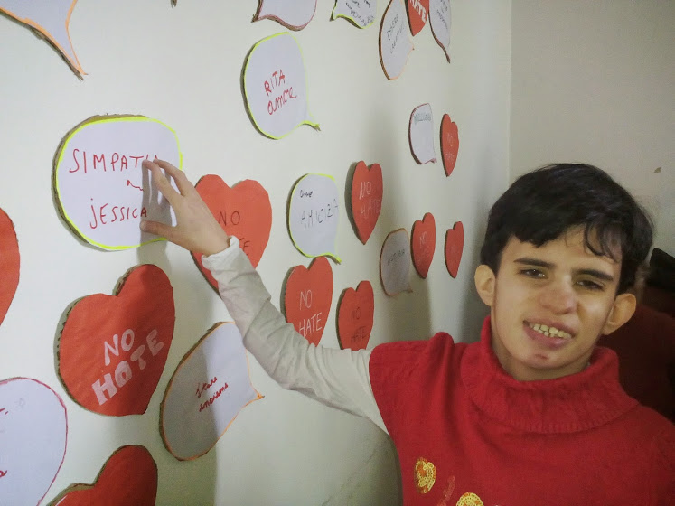
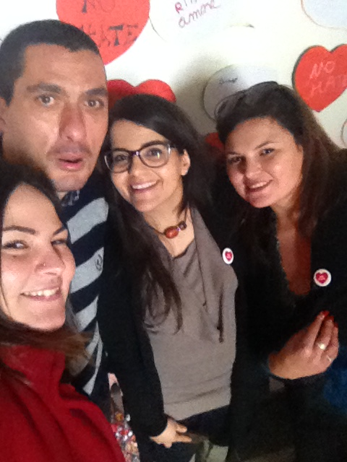
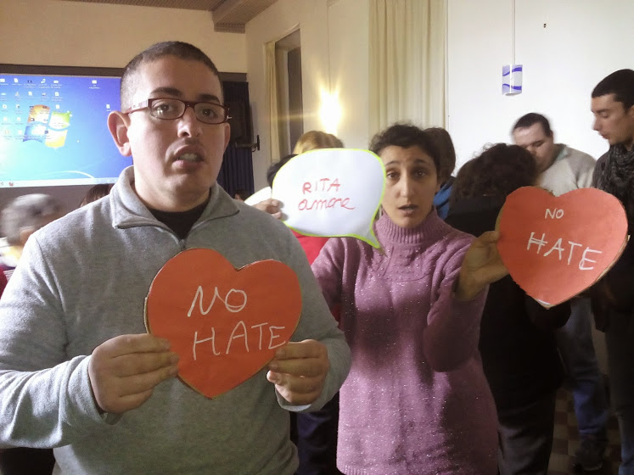
I PROTAGONISTI

Slide 8
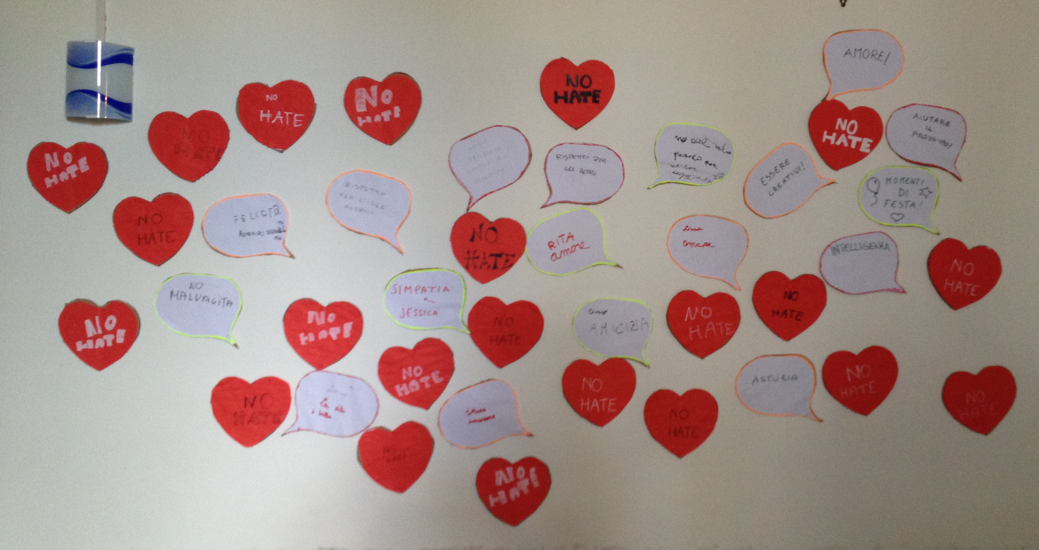
“Il Puzzle della Responsabilità”

Slide 9
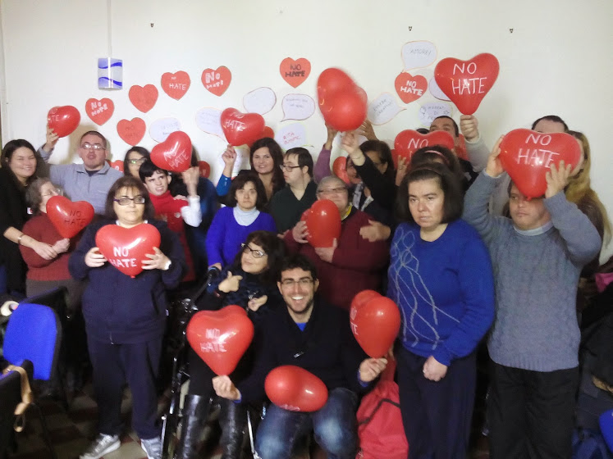

Slide 10
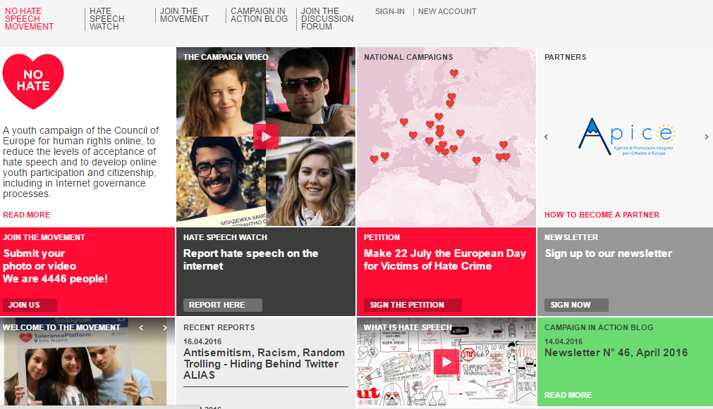
APICE: Quale ruolo nel No Hate Speech Movement?

Slide 11
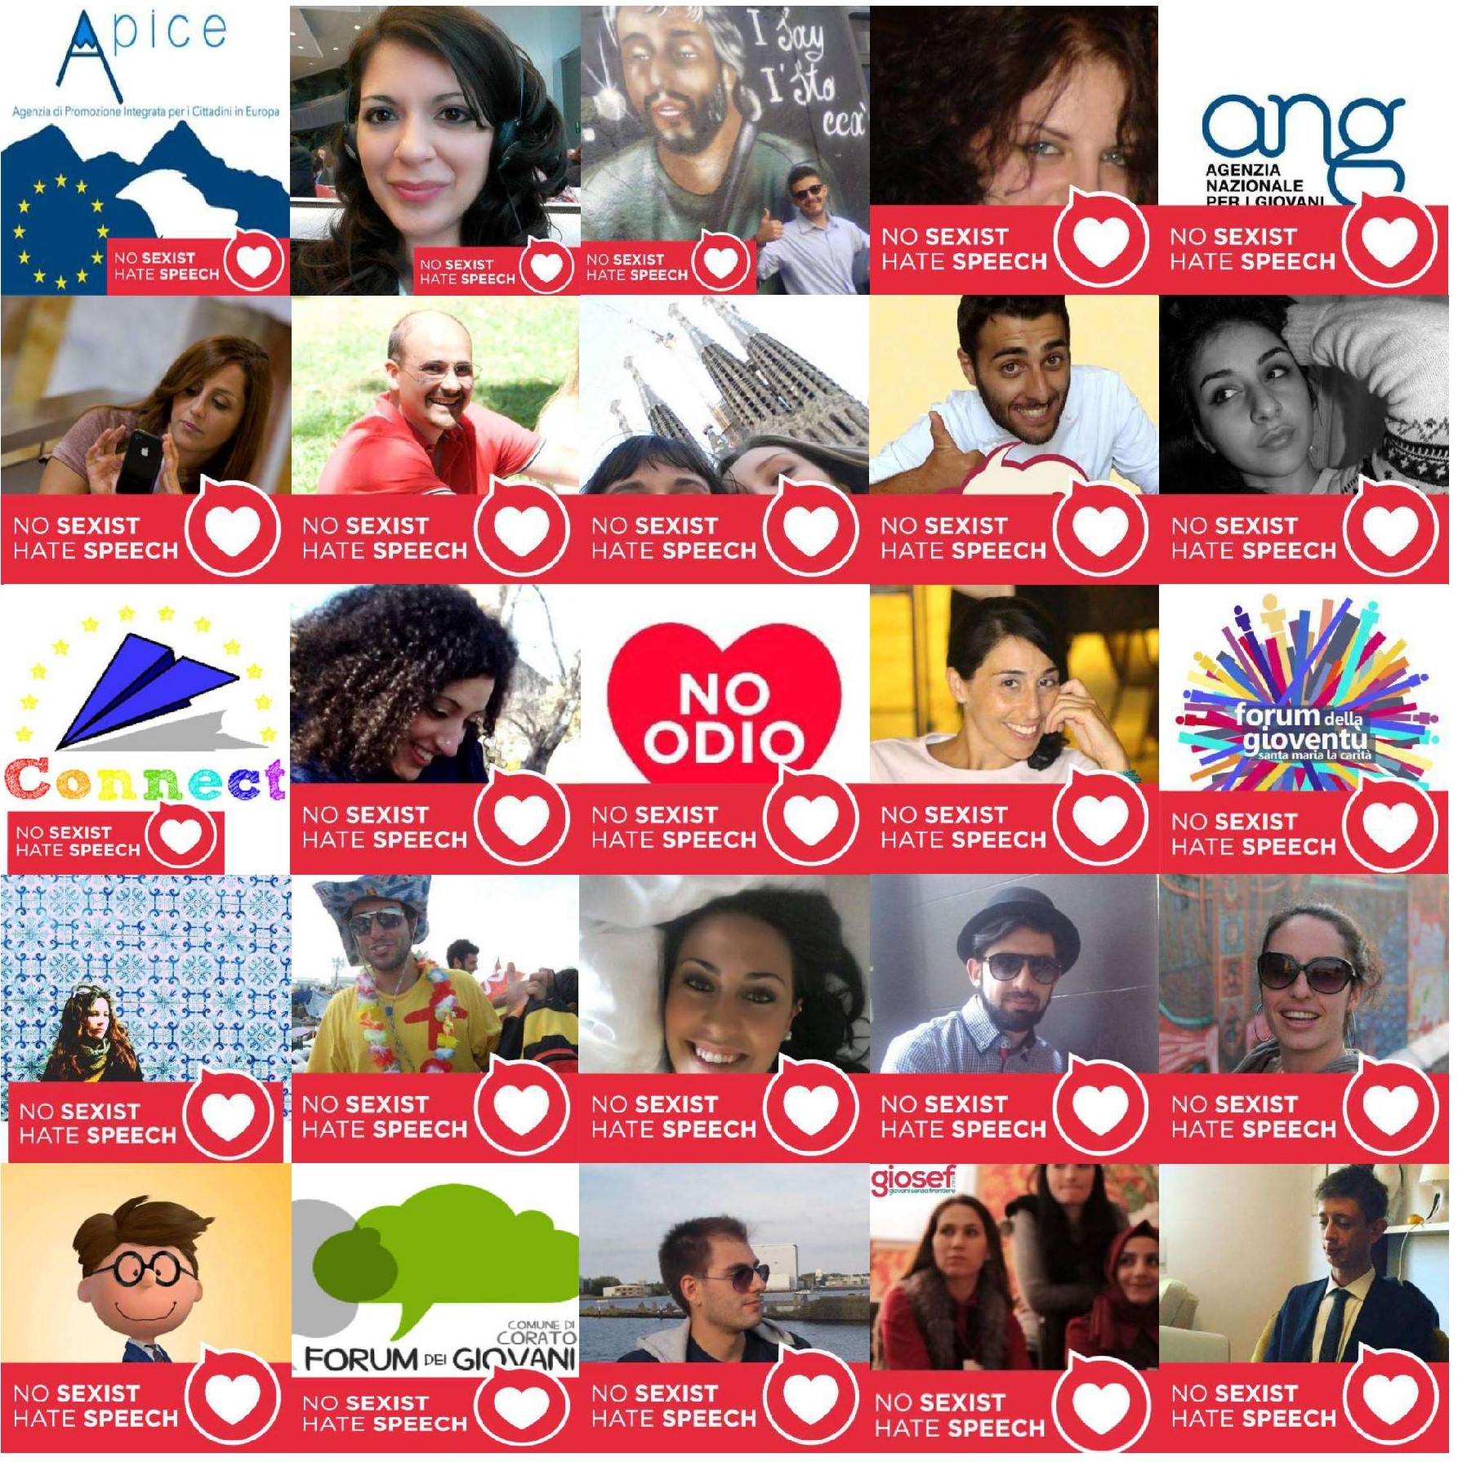


La RETE APICE PER IL NO HATE SPEECH MOVEMENT: il Coordinamento e le European Action Days

Slide 12
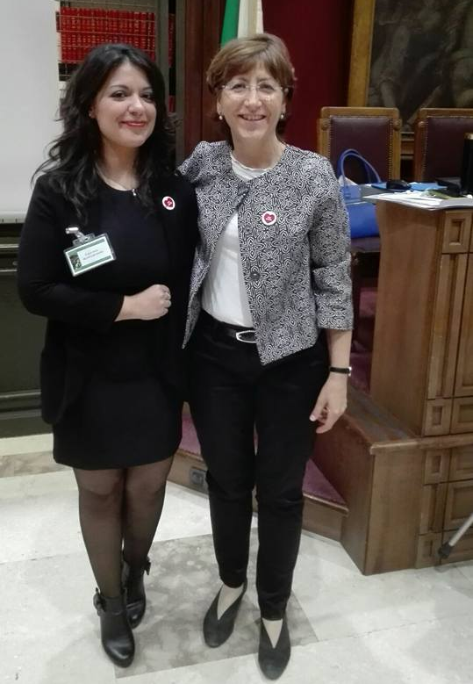
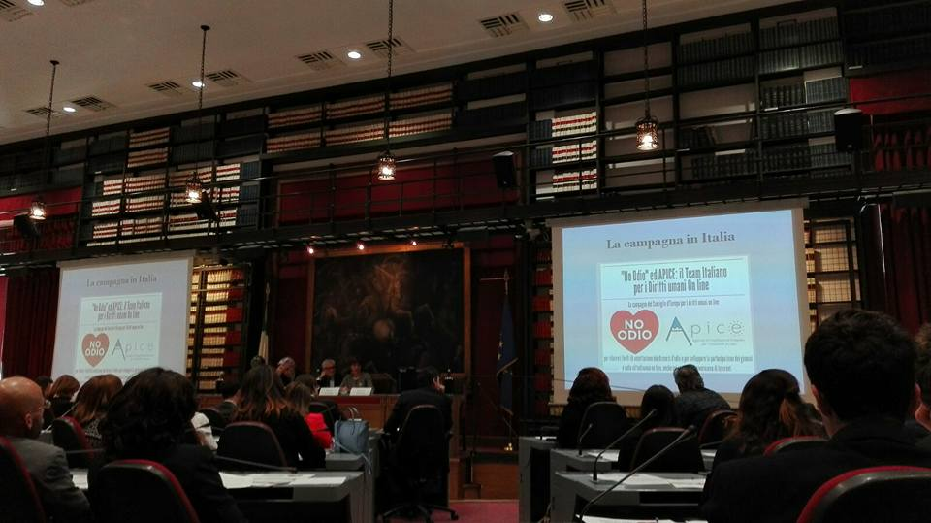
La RETE APICE PER IL NO HATE SPEECH MOVEMENT e la “No Hate Parliamentary Alliance” del Consiglio d'Europa

Slide 13


CONTATTI
www.apiceue.net
apice.ue@gmail.com
https://www.facebook.com/apiceue
https://www.facebook.com/groups/APICEnetworkNHSM/
@ApiceUE @No Hate Speech_IT

Slide 14


