Slide 1


Gorizia Conference
29 April 2016
Notes:
Optional films:
Short trailer: https://www.youtube.com/watch?v=jZljgsRnTgU
For information:
Full NHSM video: https://www.youtube.com/watch?v=35rAykWyPrg
Unicorn video explaining issue of online hate speech: https://www.youtube.com/watch?v=kp7ww3KvccE

Slide 2

Why a Campaign?
Combating hate speech by mobilising young people
Utøya terror attack in 2011
Incidence of suicide caused by cyber-bullying
Joint Council of Youth recognised a gap in work on human rights on-line
Project initiated in 2013 to raise awareness and help prevent a trend being set
Notes:
How did it start?
Utøya, terror attack, hateful rhetoric of Breivik was spread online before and after the attack
Growing reports of suicides among young people due to cyber bullying
Growing recognition that hate speech on-line was a human rights violation
Revealed a gap in international or national activity: no concerted response
First adopted in Joint Council on Youth in 2013, which concluded that a response was needed, and that CoE needed to be in the lead
Youth Department, through trial and error, built a campaign approach, producing educational tools to assist volunteers, NGOs and governments, at national level, raise awareness
Clear understanding from beginning that campaign needed to focus on prevention, and to combine warnings of negative behaviour with positive messages around the internet being a public space where freedom of expression and human rights apply to everyone

Slide 3
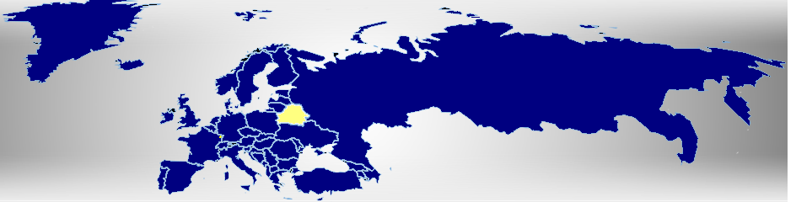

Council of Europe
Human Rights, Democracy,
Rule of Law
1949 – 47 states

Slide 4
ECRI Recommendation 15
on Hate Speech
What is hate Speech and incitement?
React to hate Speech by Public figures
Self regulation of Media
Withdraw support from political parties using hate speech
Raise awareness
From Recommendation to Action! ?
Notes:
Encouraging speedy reactions by public figures to hate speech, promoting self-regulation of media, raising awareness of the dangerous consequences of hate speech, withdrawing financial and other support from political parties that actively use hate speech and criminalising its most extreme manifestations, while respecting freedom of expression, are among the general policy recommendations issued by the European Commission against Racism and Intolerance (ECRI) on 21 March.
In support of the recommendation ECRI also published a report on ‘Cyberhate’; and a fact sheet on hate Speech by the European Court of Human Rights is also available.

Slide 5
Council of Europe Strategy
on Internet Governance
Respect for Human Rights online
Dialogue between Governments and Companies
Standards on freedom of expression and blocking, filtering and taking down.
Education on Media literacy
Redress for internet users when their human rights were breached online
From Recommendation to Action! ?
Notes:
Internet Governance Strategy for 2016-2019, which aims at tackling the challenges to human rights, democracy and the rule of law in the rapidly evolving online environment.
With the strategy, the Council of Europe endeavours to help its 47 member states to effectively protect and respect human rights and the rule of law online, and to empower people to explore the potential ofInternet for education and democratic participation.
The following are some of the actions planned:
Set up a platform between governments and major Internet companies to promote respect for human rights online;
Develop concrete measures to address concerns about mass surveillance and bulk interception of data;
Develop standards on the role of Internet intermediaries with regard to freedom of expression, taking into account best practices on blocking, filtering and takedown of Internet content;
Launch a consultation on European education aiming at preparing a white paper on media and information literacy
Promote the setting up of a network of national institutions to guide Internet users to seek redress when their human rights were breached online;
Conduct a triennial reporting on the state of data protection on the Internet in Europe;
Assess and review the governance of mobile health and electronic health.
For more info see: http://www.coe.int/en/web/freedom-expression/internet/-/asset_publisher/pQh9HAwVBXXh/content/protecting-and-empowering-people-on-the-internet-new-internet-governance-strategy?inheritRedirect=false&redirect=http%3A%2F%2Fwww.coe.int%2Fen%2Fweb%2Ffreedom-expression%2Finternet%3Fp_p_id%3D101_INSTANCE_pQh9HAwVBXXh%26p_p_lifecycle%3D0%26p_p_state%3Dnormal%26p_p_mode%3Dview%26p_p_col_id%3Dcolumn-1%26p_p_col_count%3D2
And see:
http://www.coe.int/en/web/portal/council-of-europe-and-internet

Slide 6
Council of Europe work on
Human Rights for all
Thematic Action Plan on the Inclusion of Roma and Travellers
Roma Youth Action Plan
Council of Europe Standards and mechanisms on Sexual Orientation and Gender Identity
Gender Equality Strategy
And more much more: www.coe.int
Notes:
Roma Youth Action Plan
The Joint Council on Youth of the Youth Department of the Council of Europe have expressed its interest and commitment in supporting the participation and inclusion of Roma young people as part of its working priorities. At the meeting during 21-23 March in Budapest, it has adopted the strategic orientations and main approaches for the implementation of the Roma Youth Action Plan for the period of 2016-2020. More information about the most recent news on the continuation of the initiative will follow at the web site of the RYAP: http://www.coe.int/en/web/youth-roma/home
Thematic Action Plan on the Inclusion of Roma and Travellers
During the first week of March the Committee of Ministers of the Council of Europe has reaffirmed its political commitment in contributing to the inclusion of Roma and Travellers by adopting a Thematic Action Plan on the Inclusion of Roma and Travellers. The document sets the strategic orientations of the Council of Europe for the period of 2016-2019 focusing on three major priorities, among which Roma youth has its particular place. The information on the thematic action plan can be accessed online.: https://search.coe.int/cm/Pages/result_details.aspx?ObjectID=09000016805c5a1d#_ftn1
Sexual Orientation and Gender Identity
The Council of Europe works to uphold human rights, the rule of law and pluralist democracy. The Council of Europe's standards and mechanisms (http://rm.coe.int/CoERMPublicCommonSearchServices/DisplayDCTMContent?documentId=090000168047f2a6) seek to promote and ensure respect for the human rights of every individual. These include equal rights and dignity of all human beings, including lesbian, gay, bisexual and transgender persons.
The Council of Europe has adopted a number of international legal instruments and standards on combating discrimination on grounds of sexual orientation or gender identity.
For more info see: http://www.coe.int/en/web/sogi/home and the HR commisioners website: http://www.coe.int/en/web/commissioner/thematic-work/LGBTI
Gender Equality:
The Council of Europe Gender Equality Strategy 2014-2017 is the guiding framework for policy change, aimed at realising real equality between women and men in the 47 member states. Activities in 2015 have reinforced the status of the Council of Europe as a leading actor on gender equality, including through the promotion of its progressive standards and the sharing of good practices.
For more see: http://www.coe.int/en/web/genderequality/home

Slide 7
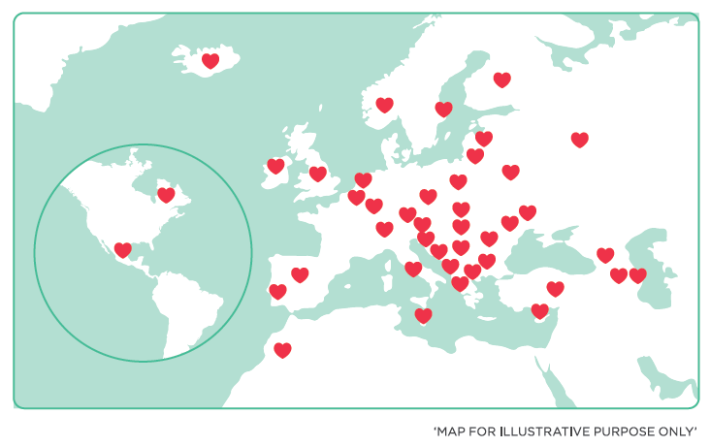
National Campaigns
50 National Campaign Committees / 60 on-line activists
60 European campaign partners
Notes:
Why important
Public recognition and participation in key events of the campaign by the government, relevant ministries and parliamentarians is essential to strengthen the campaign at national level
The 50 National Campaign Committees bring together representative of youth and civil society organisations, human rights bodies, and governmental representatives (ideally Ministry Youth affairs, Education and in some countries Justice or social affairs). They coordinate and support the implementation of the campaign at national level, seeking cooperation and alignment with existing initiatives and structures
Non member states involved: Morocco, Québec, Mexico
Community of 60 on-line activists run the online media campaign, moderate discussion blog and a reporting tool called Hate Speech Watch – come back to that later
60 European Campaign partners, European NGO’s, networks and organisations embrace the campaign objectives and seek cooperation on actions and joint initiatives.
Good example
Portugal: NCC involved over 30 Youth civil rights, human rights organisations, Ministry on Youth affairs and Ministry of Education. Multipliers: Trainings of youth workers, and teachers, seminars and evaluation conference. General public and youth: HS and HR online integrated in school curricula on information and communication technology, Information to parents, Action days with public events in cooperation with municipalities. Online and Offline: Youth activists No Hate Ninja’s and Unicorn video on what is hate speech and HR online tour through the country. Small financial support provided by Ministry
Strengthen involvement of the No Hate Speech Parliamentary Alliance – they will hold twice a year meetings in member states. First one in April in Italy.

Slide 8
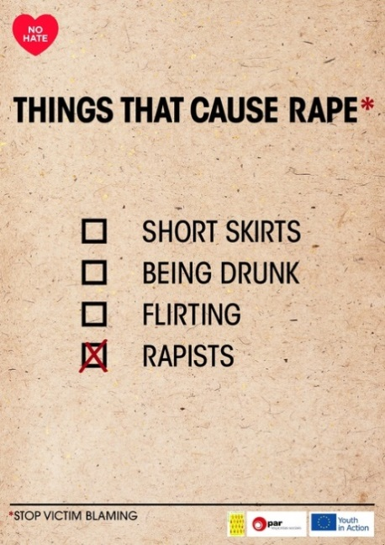

2016-17 priority areas
Education
Reporting
Counter narratives
Youth participation in
Internet Governance
Antisemitic Hate Speech
sexist Hate Speech
refugees/migrants Hate Speech
root causes of extremism
Notes:
The Campaign objectives for 2016-17 include:
Support HRE against hate speech and the risks it poses for democracy and well-being of young people
Developing tools for reporting hate speech, including through those at national level
Mobilising national and European partners to prevent and counter hate speech, through counter-narratives
Promoting media literacy and digital citizenship and support youth participation in Internet governance
EDUCATION:
Education through Bookmarks manual and European, Regional and national level trainings.
Integrate Hate Speech and internet governance in school curricula (as part of internet literacy education and Human Rights Education)
Support teacher and school manage to address hate full narratives expressed as hate speech with counter narratives based ont eh values of human rights and democratic participation.
Bookmarks languages available:
Published:
Armenian – Finish – French – English – Greek – Hungarian – Macedonian – Norwegian – Polish - Ukrainian
In progress:
Italian – Icelandic – Swedish – Russian – Romanian – Montenegrin - German
New thematic focuses are:
Anti-semitism: assumed covered by specialised organisations already and we did not realise its increase in the online space
Sexist: often trivialised and its full extent not understood
Hate Speech directed at refugees, migrants and asylum seekers: a response to the present influxes of refugees and the populist nationalist response that challenge human rights and solidarity principles
Root causes for hate speech leading to radicalisation: campaign provides a platform for youth to understand the danger of hateful and discriminative narratives that lead to hate speech posses for democratic societies and themselves
ENTER recommendation on access to social rights for youth from disadvantaged neighbourhoods and the Recommendation on Youth Rights and Recommendation on Youth work are tools to this process of addressing disengagement with society and the pull of radical ideologies
BUT despite featuring in the CoE Action Plan on the fight against violent extremism and radicalisation leading to terrorism, the campaign is focused on broad prevention and does not tackle radicalisation specifically
Youth participation in Internet governance: there has been little understanding (among NCC and Youth) how civil society can be part of the debate on promoting and protecting human rights online and how to engage effectively with internet service providers and social media companies. This needs education and creating opportunities for (young) civil to get engaged
Existing campaign focuses remain (carried by groups of NCCs – and specially the member organisations of those NCC’s who work on those topics): homo and transphobia, Romaphobia, Islam phobia and religious belief, minorities targeted by hate speech, migrants

Slide 9
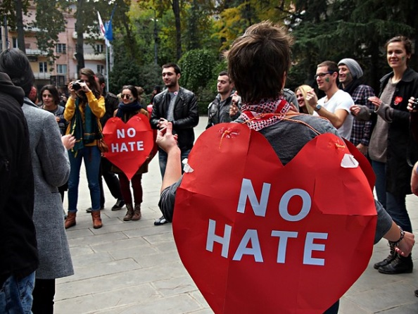

Take action !
Human Rights Education
Report
Speak up for
Policy
Human Rights Standards
Youth Participation

Slide 10
Take Action: Action Days 2016
8 March on sexist hate speech
20 June support refugees targeted by hate speech
22 July for the victims of hate crime
9 November combating Antisemitic hate speech
10 December on human rights online
Notes:
Action Days mobilise National Campaign Committees, on-line activists and campaign partners to take action on a specific issue of concern across Europe.

Slide 11
How to join
Internet www.nohatespeechmovement.org
Facebook www.facebook.com/nohatespeech
Twitter https://twitter.com/nohate_speech #nohatespeech
Youtube: www.youtube.com/nohatespeechmovement
Join the national campaigns
Email: youth.nohatespeech@coe.int

