Slide 1

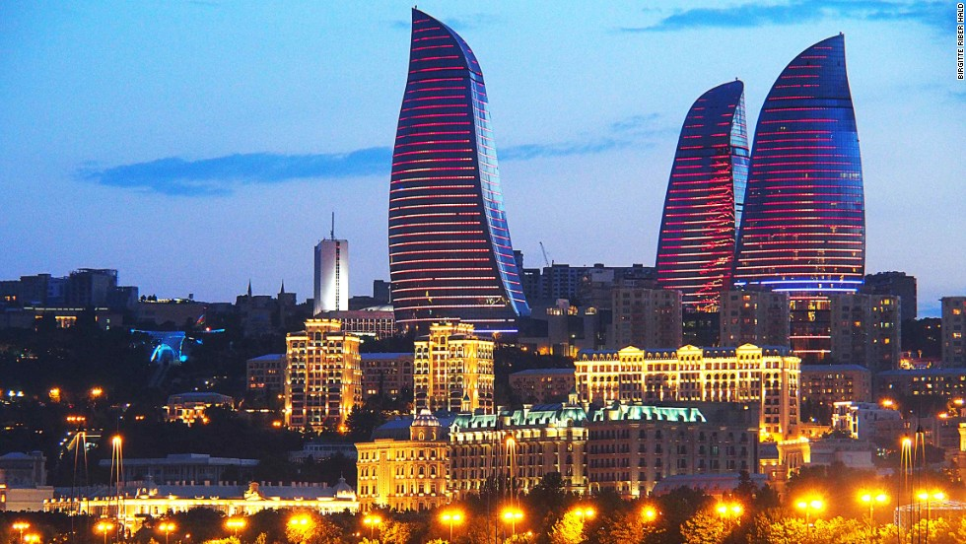
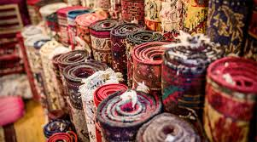
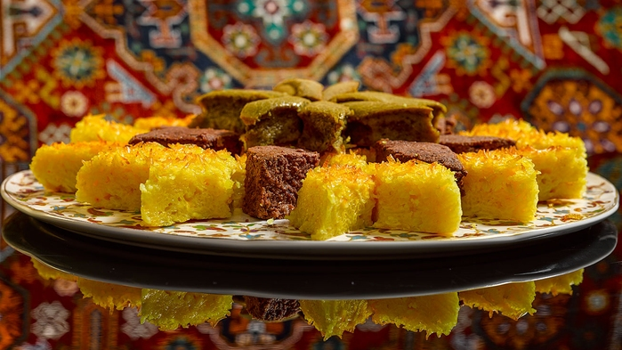
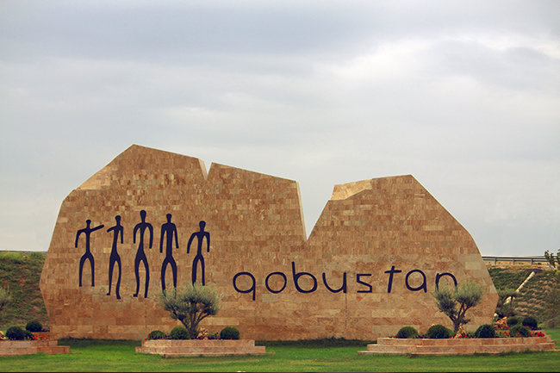
AZERBAIJAN – LAND OF FIRE

Slide 2

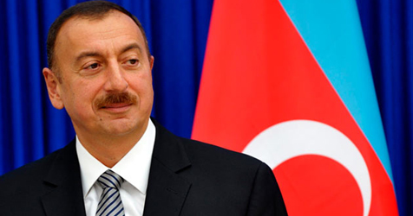
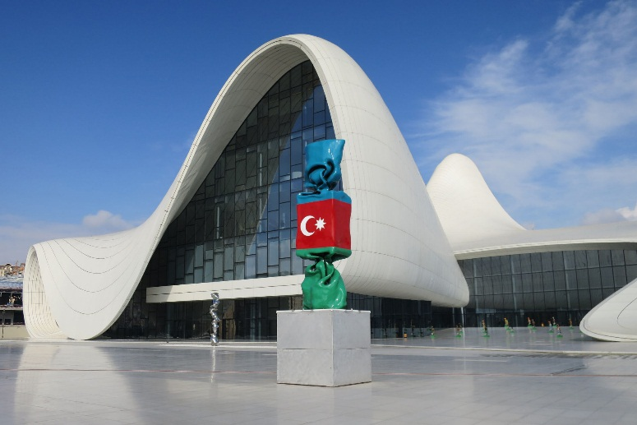
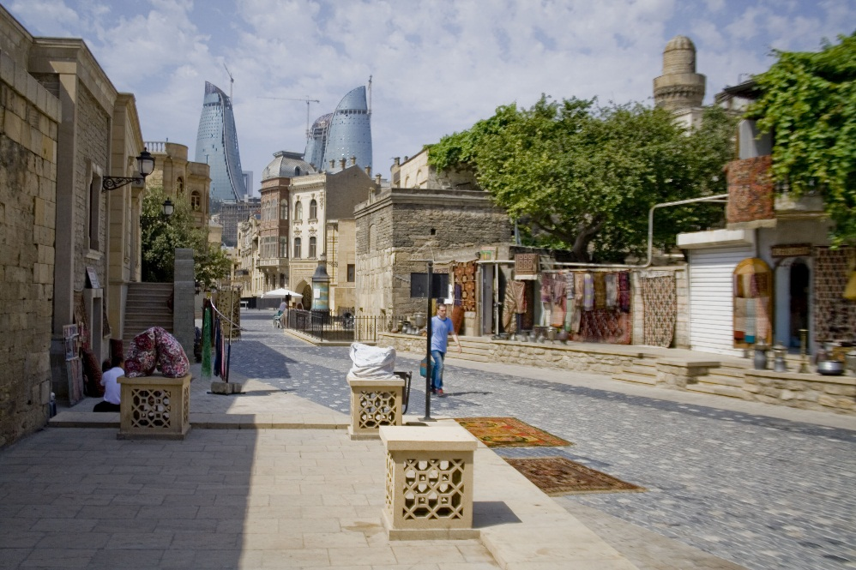
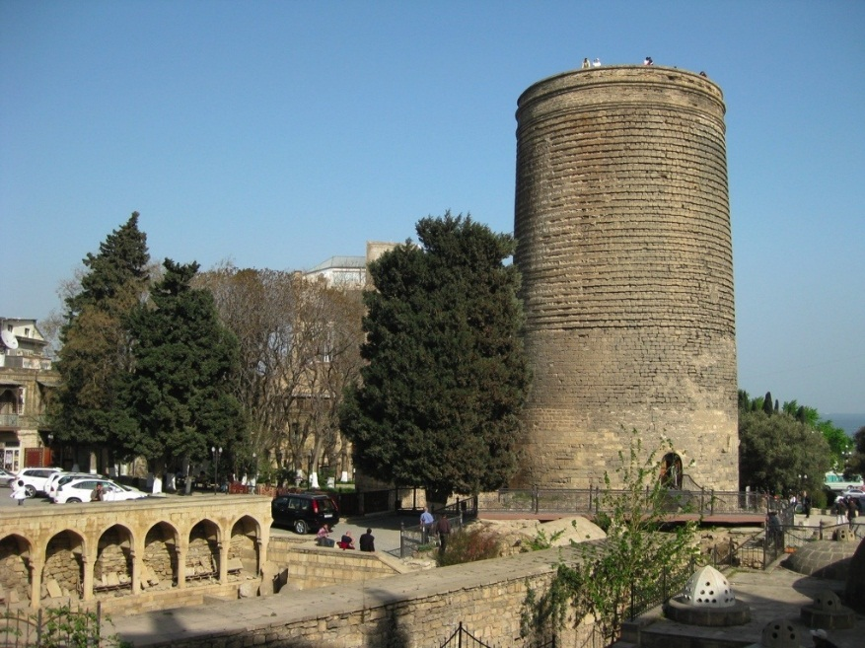
About…
Capital – BAKU
Official Language – Azerbaijani
Government – Unitary dominant-party semi-presidential republic
President – Ilham Aliyev
Prime minister – Artur Rasizadeh
Legislature – National Assembly
Indepence from – 18th October, 1991
Constitution adopted – 12 November, 1992
Municipalities – 1607

Slide 3
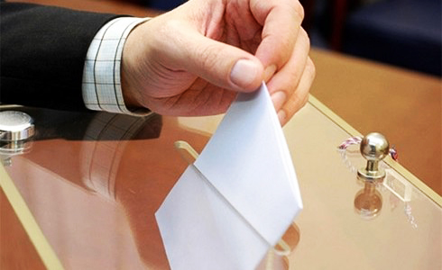
Municipalities…
Last elections – 2014
Municipalities – 1607 (14963 members)
- city municipalities – 73,
- settlement – 148,
- town – 1386
Women – 5236 members – 34,99 %
Youth – 5450 members – 27,6 %
Ruling party members – 10487 – 67,3 %
Other party members – 879 – 6,6 %
Neutral members – 4225 – 27,1 %

Slide 4

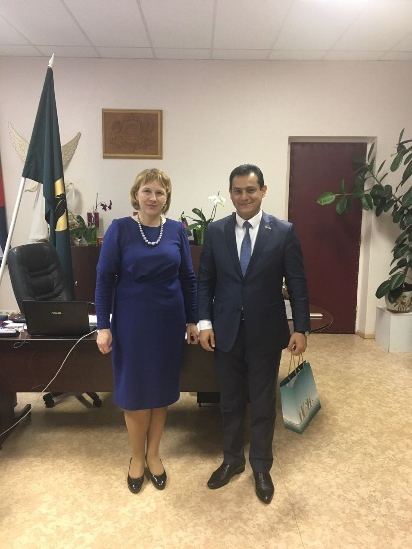
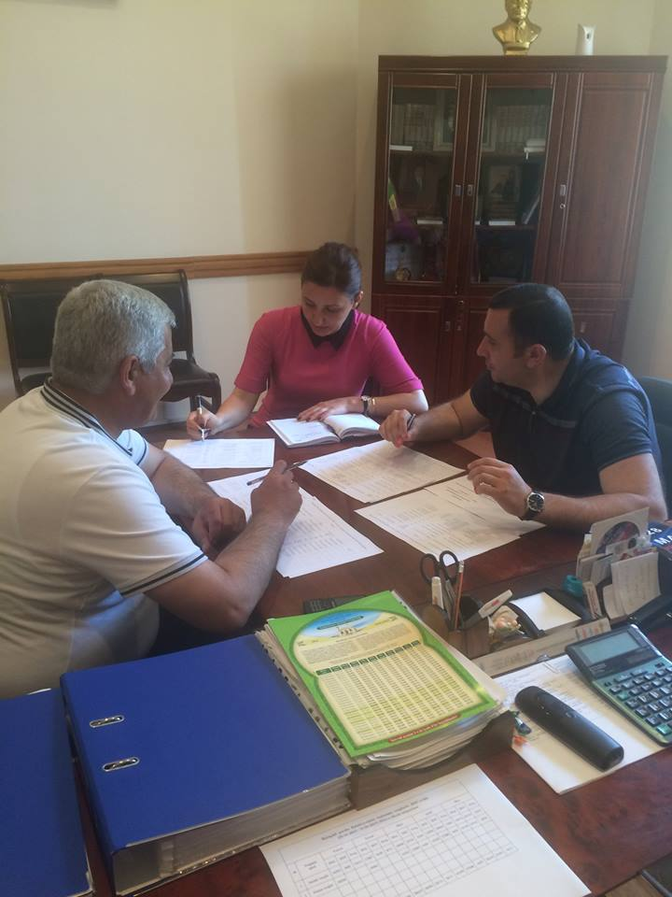
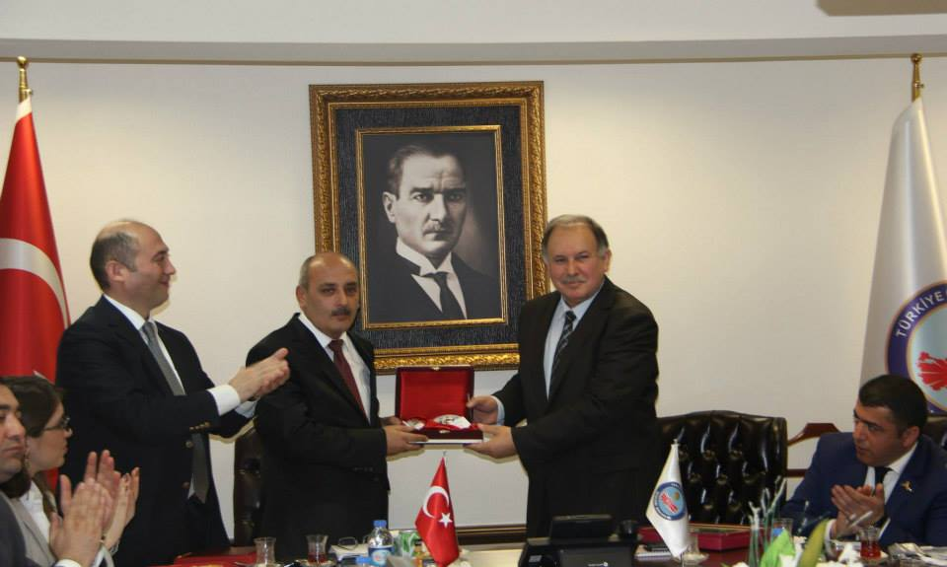
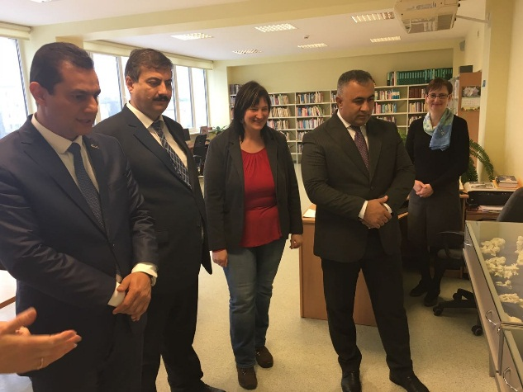
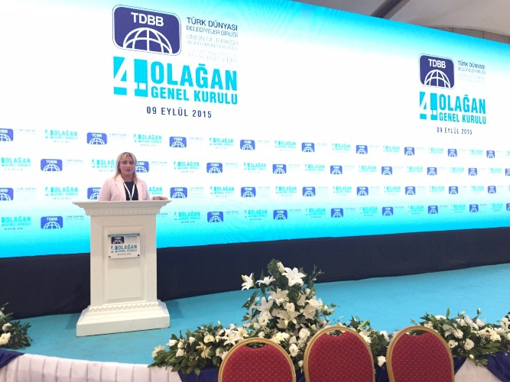
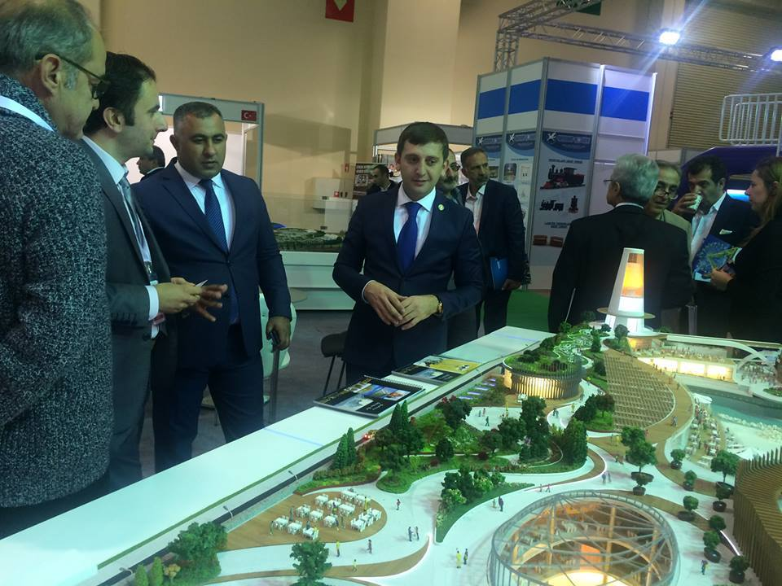
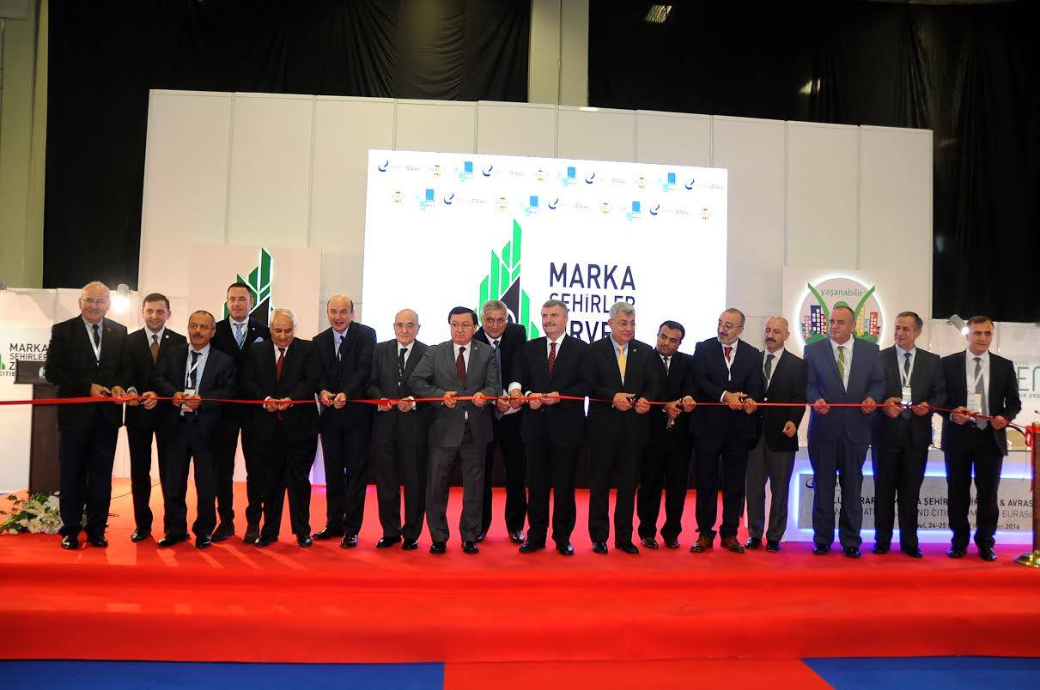
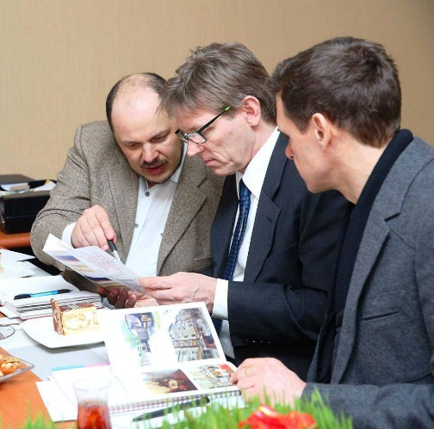
IMC in LAW…
Constitution of the Republic of Azerbaijan – Chapter 9, Article 142 – 146
Azerbaijan adopted European Charter. Article 10, item 3 - Local authorities shall be entitled, under such conditions as may be provided for by the law, to co-operate with their counterparts in other States.
The Law on the Status of municipalities, Article 10, item 1 – Municipalities and Associations of Municipalities can sing an agreement with other country municipalities to improve cooperation and can become members of any other international organizations.
Signed Agreements – Lithuania, Latvia, Estonia, Turkey, Russia, France, Germany, Poland…

Slide 5

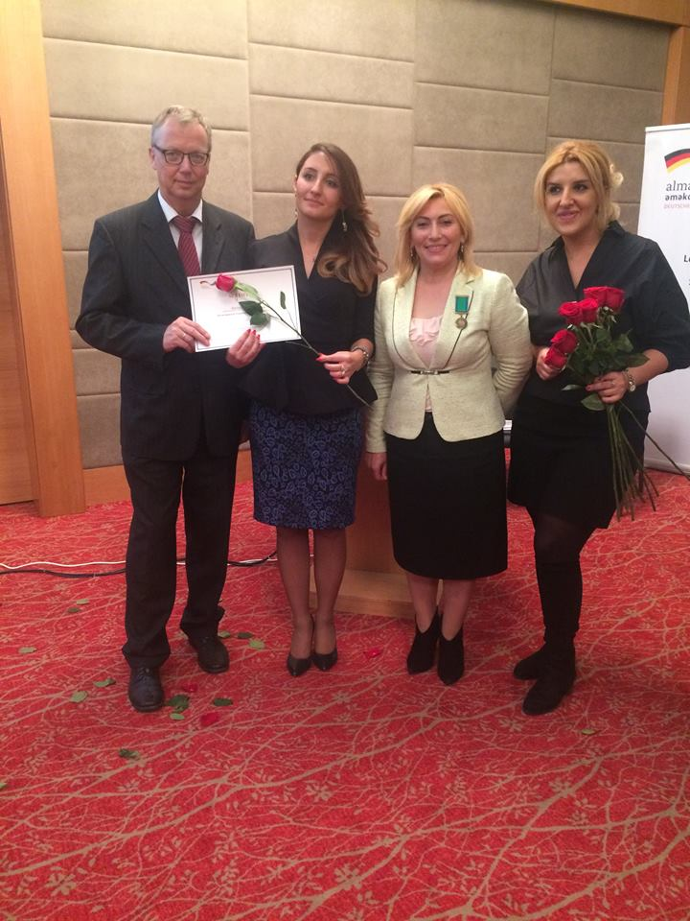
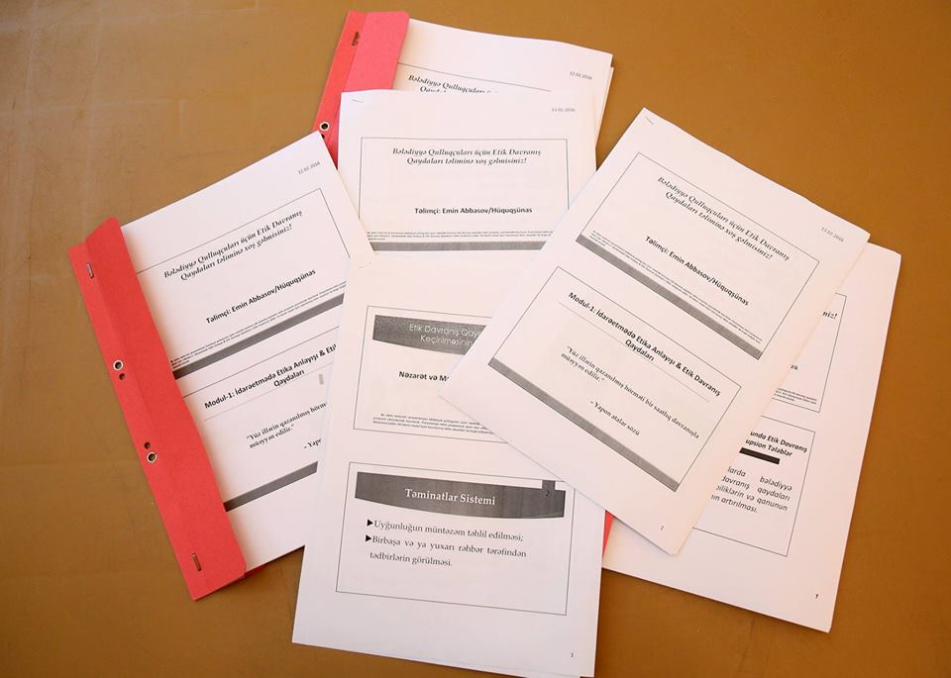
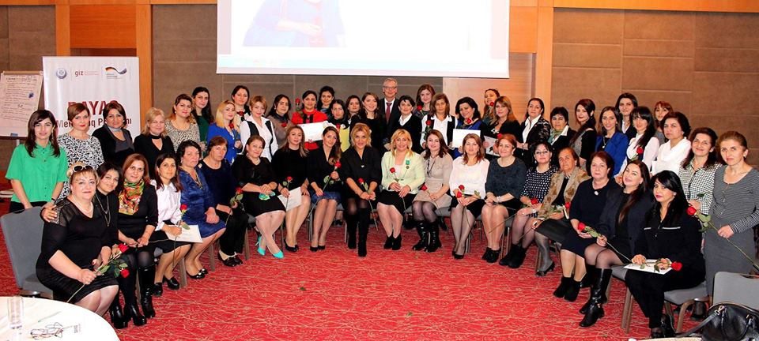
Financial incentives…
Taxes
Dotations
NGOs
Grants

Slide 6
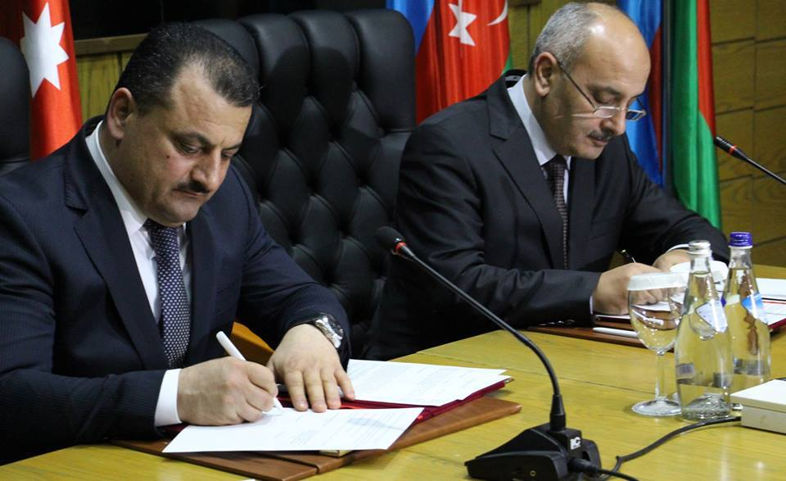
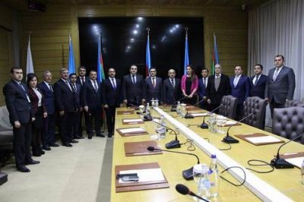
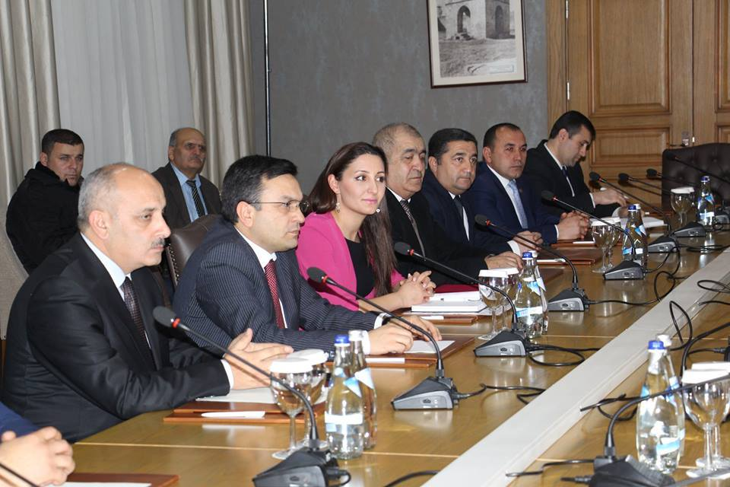
REFORMS…
Ministry of Justice – normative – legal acts
Working groups in the Parliament…
Reports given by municipalities…
Visits and exchanging views – practices
Agreements with local municipalities – Binagadi-Shamkir, Binagadi-Gadabey, Binagadi-Ismailly…

Slide 7
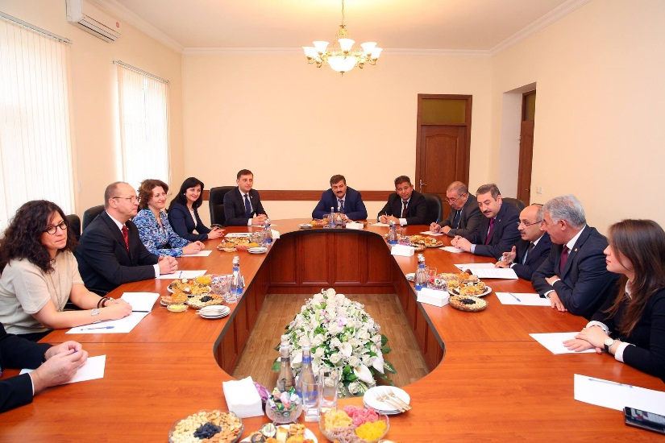
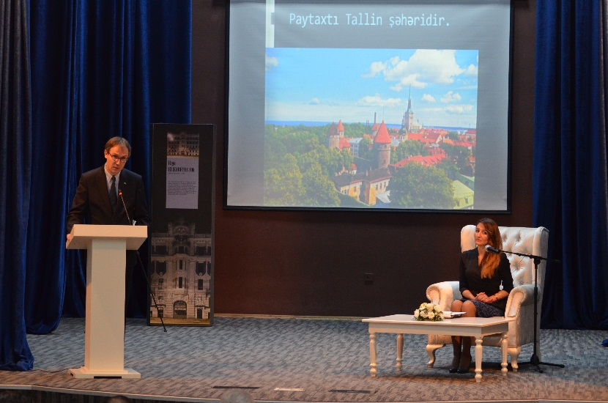
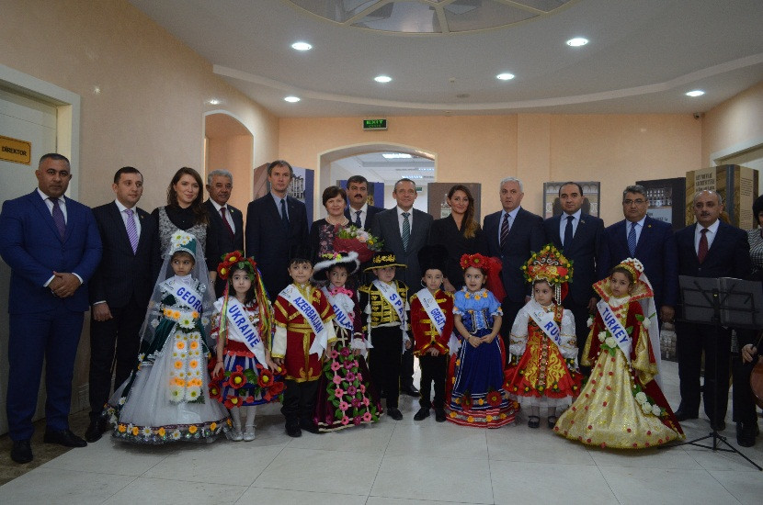
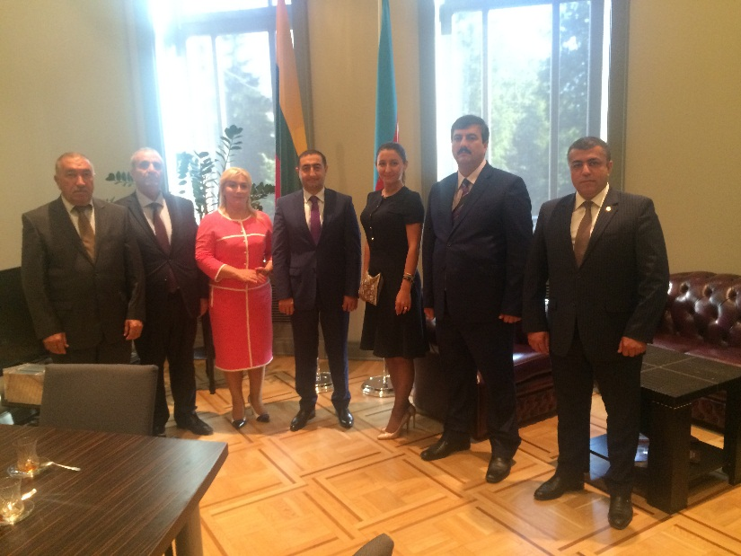
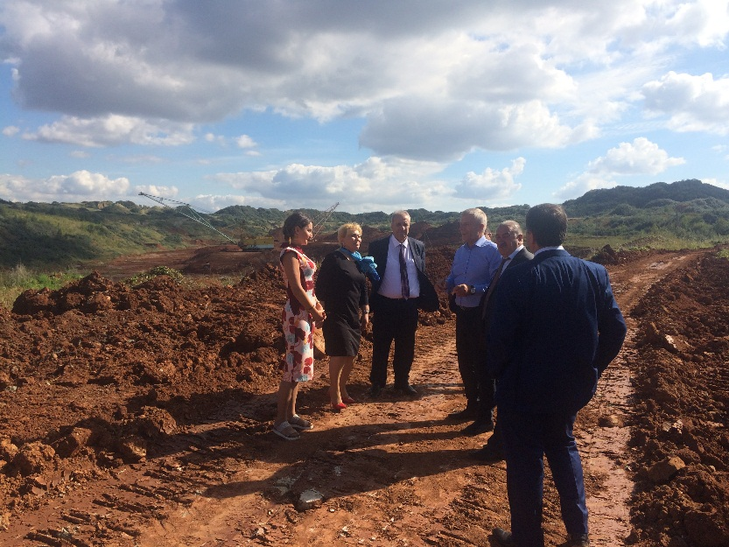
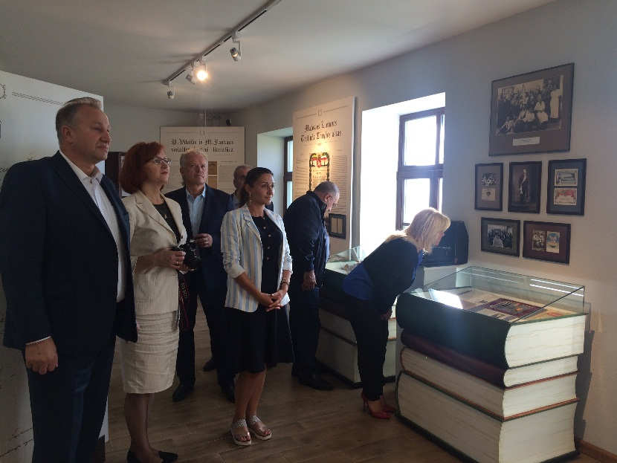
We are in facts…

Slide 8

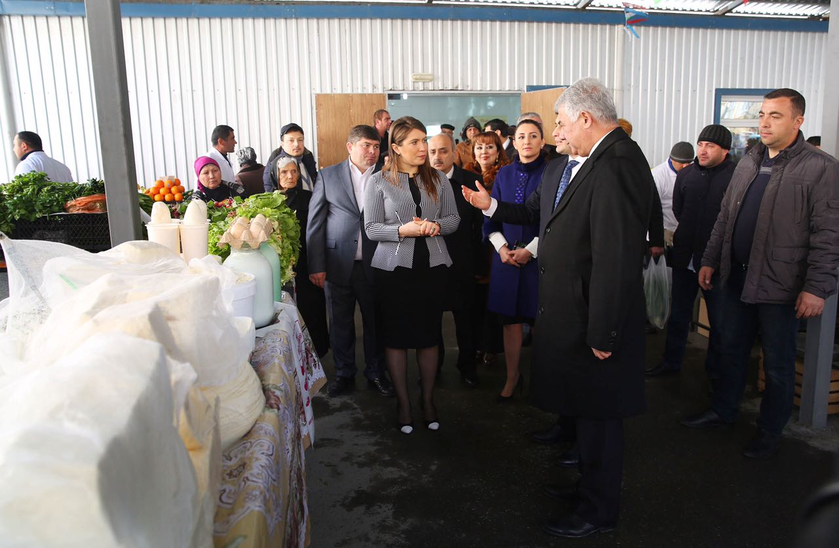
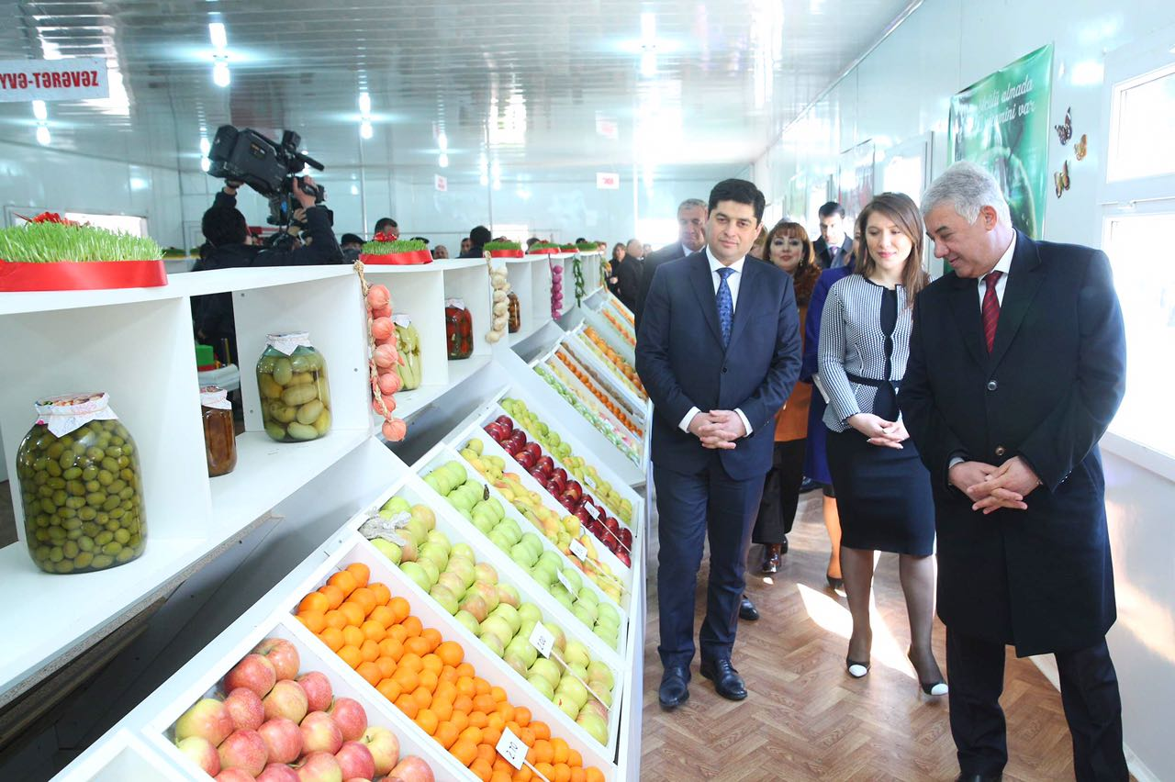
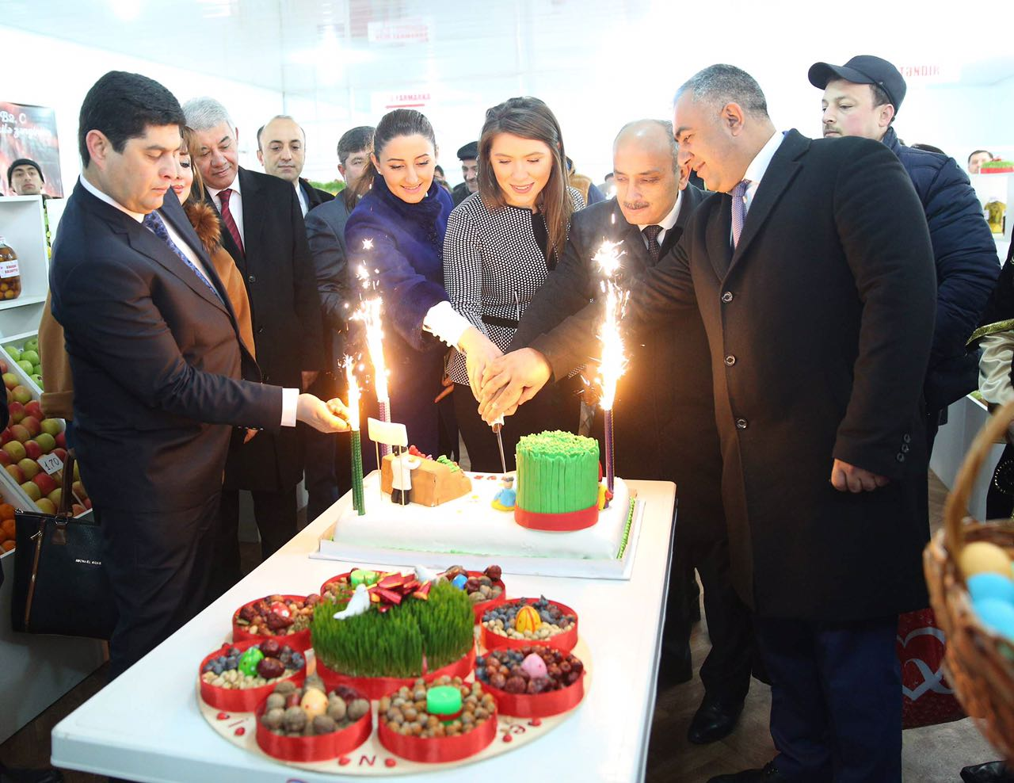
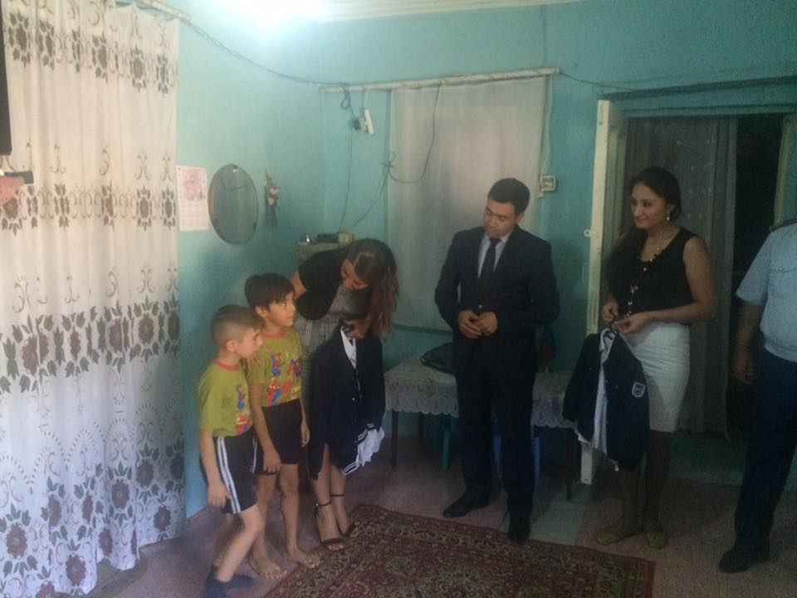
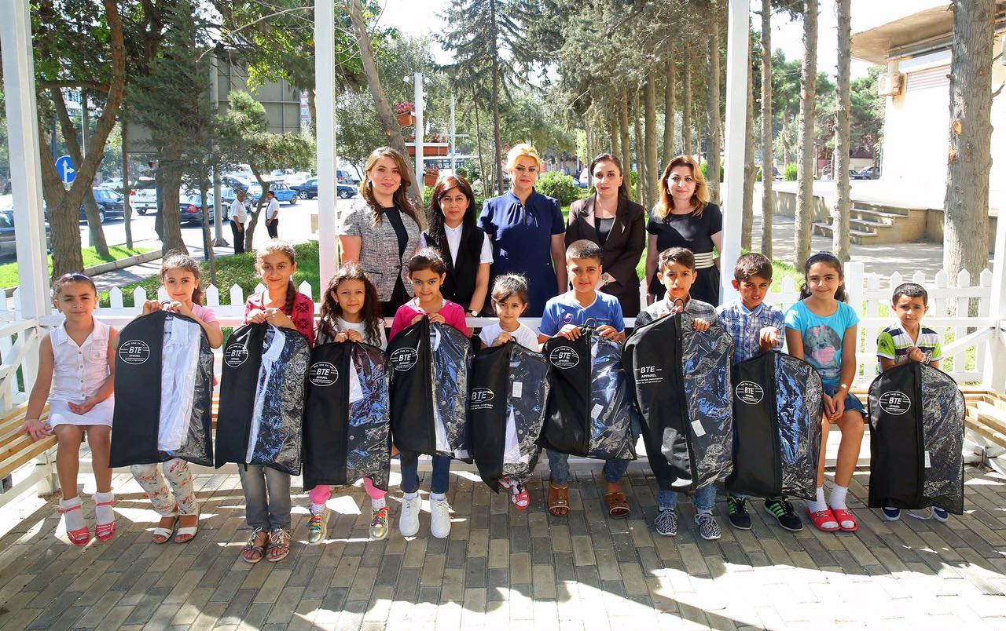

Slide 9
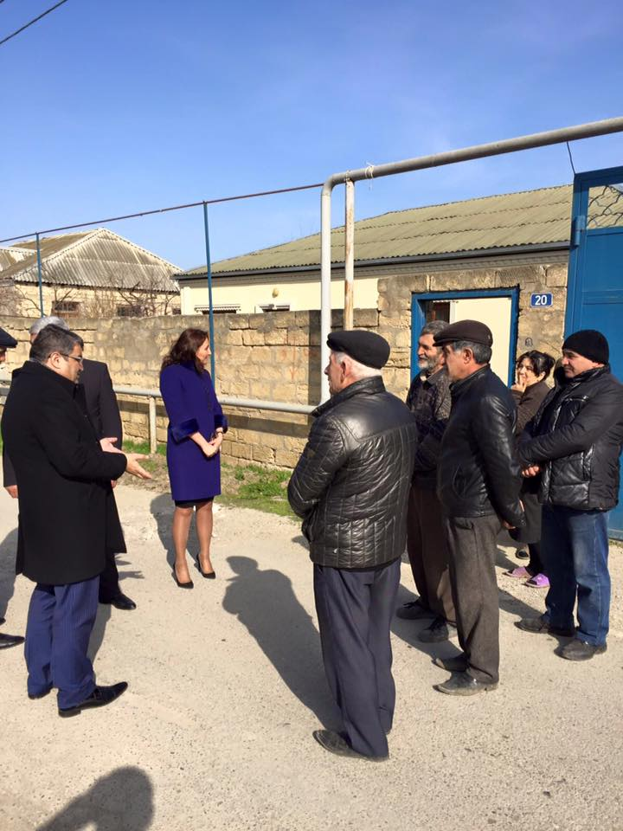
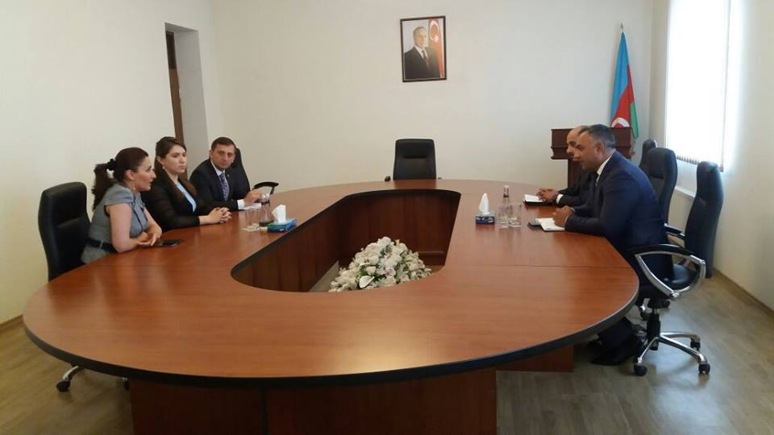
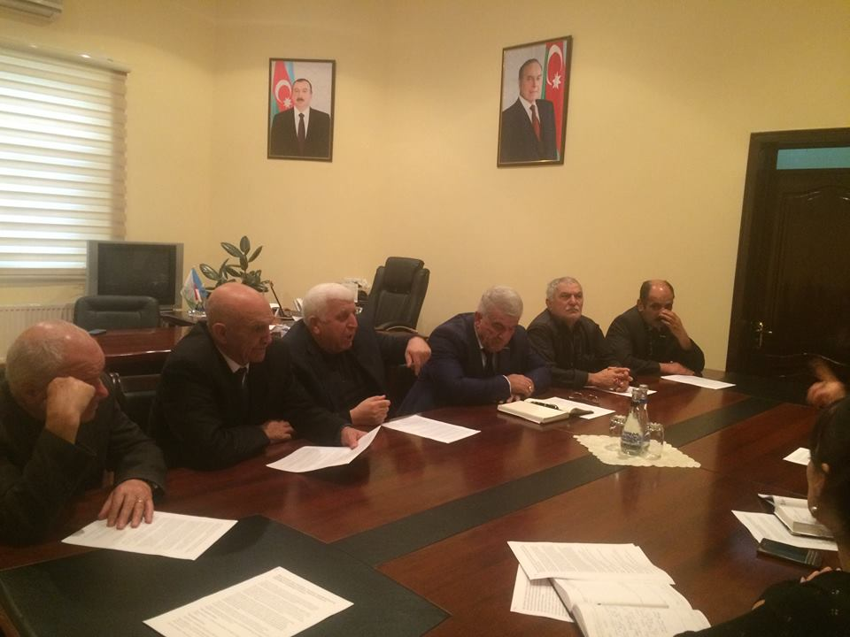

Slide 10
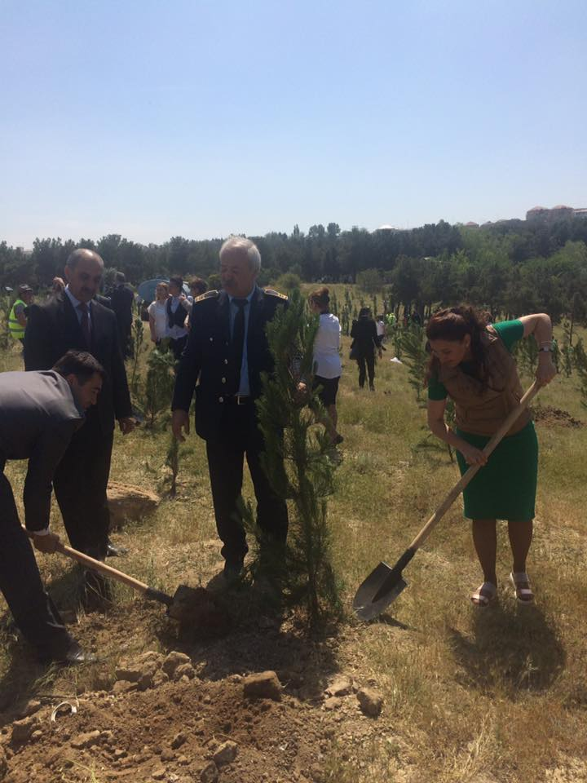
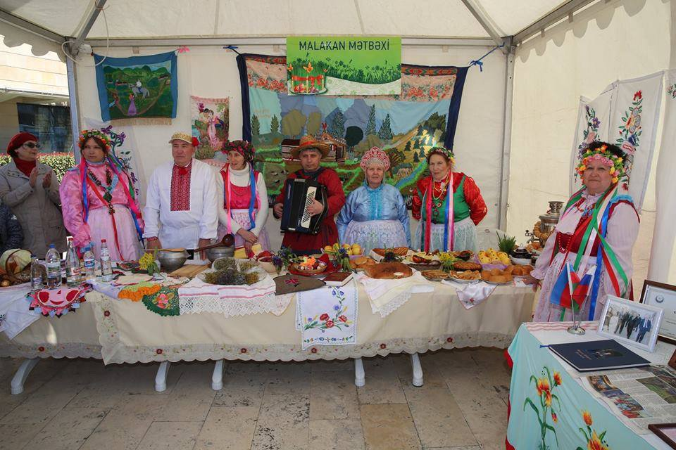
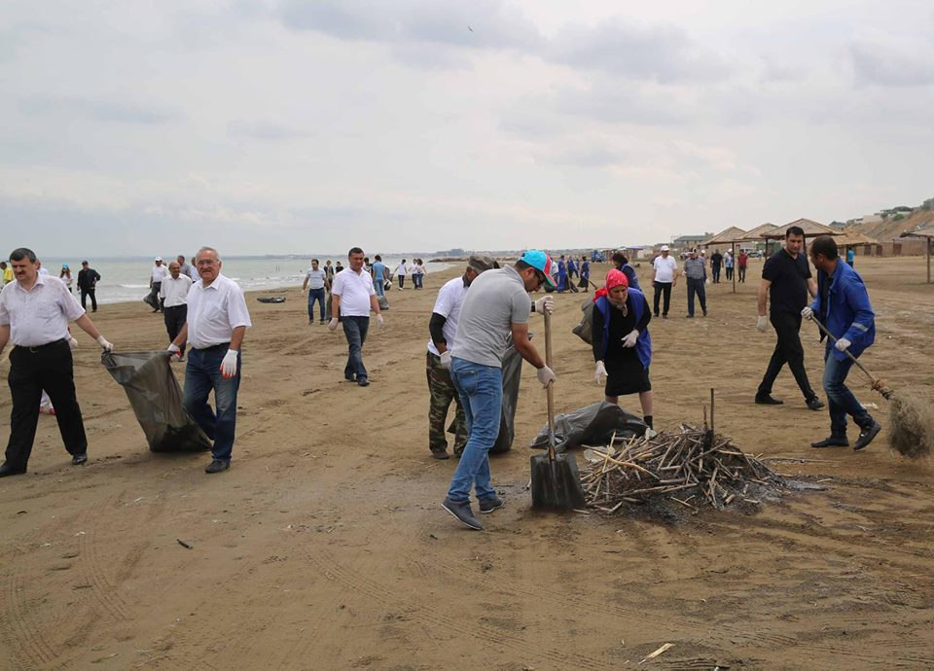

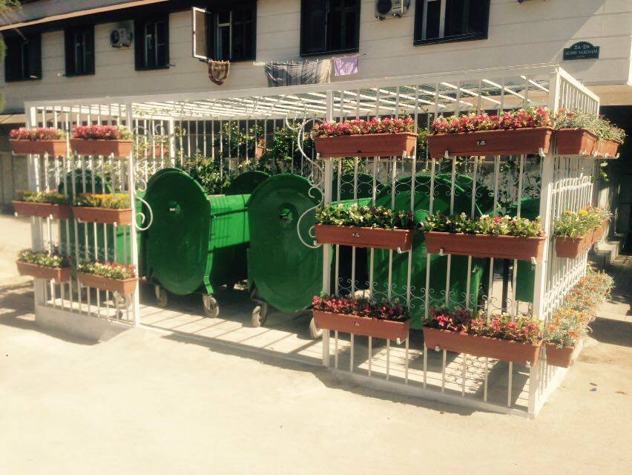
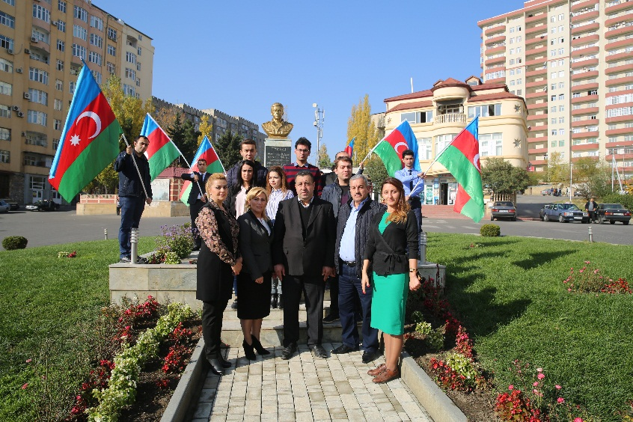
Social projects…

Slide 11
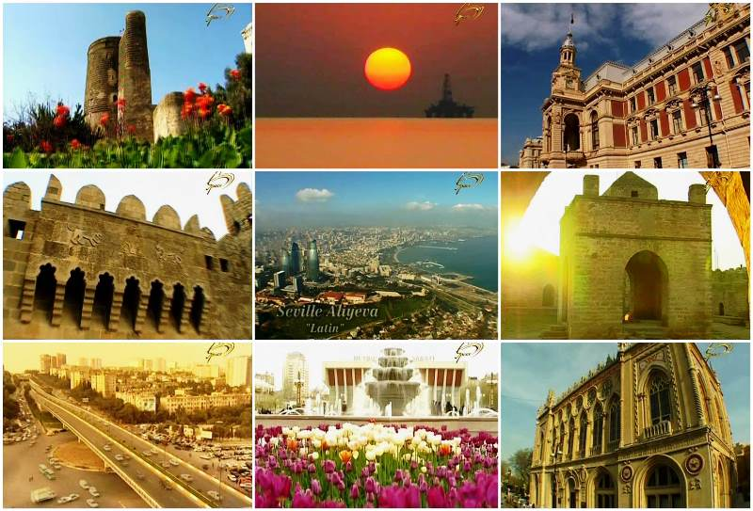
WELCOME TO AZERBAIJAN

